Slide 1
Programming and Algorithm
Lab 4: Basic Programming(Conditional Statement, Loop)

Slide 2


Welcome to Basic Programming Class

Slide 3


What is Conditional Statement?
Conditional Statement is a statement upon which we can take decisions.
Ex: If you give me Pen Then I will give you Chocolate!

Slide 4
Conditional Statements
IF statement
IF- ELSE statement
IF-Else if- ELSE statement
Switch statement

Slide 5
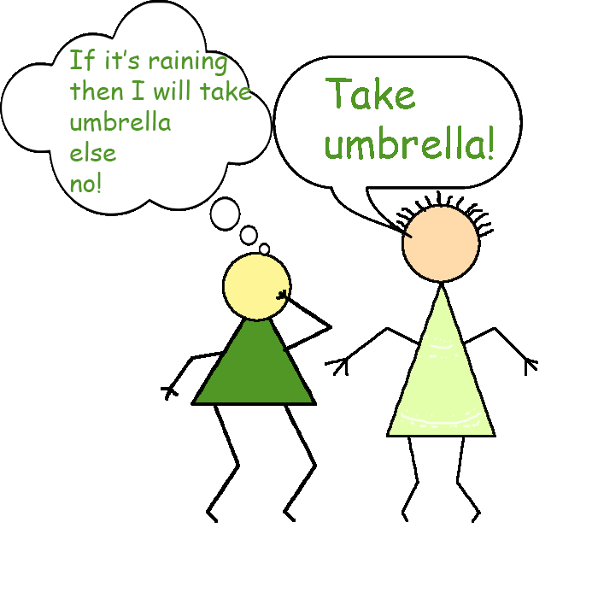
IF Statement
IF statement works like “if condition is met, then execute the task”.
The action is executed only when If condition is true..
Because It’s Raining!!

Slide 6

IF-ELSE Statement
"If condition is met, then execute a specific task and If not met then execute another specific task“.
If the condition become true then execute the task for true
OR
If false then the task of ELSE statement should be executed.

Slide 7
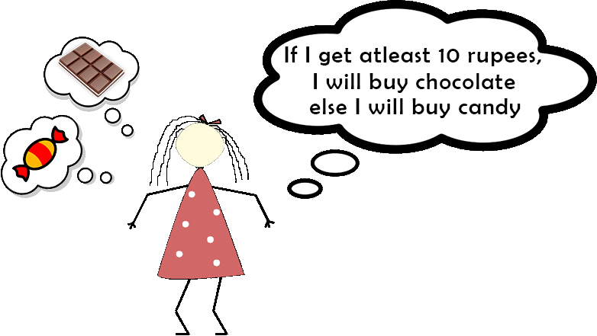
Example: IF ELSE Statement
TAKA

Slide 8
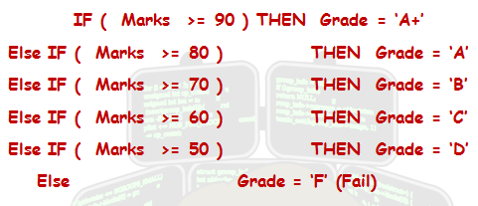
IF-Else if- ELSE Statement
This Statement works like exactly the way If..Else statement does except-Here can be multiple Else Condition which is represented by ‘Else If’.

Slide 9

What is Loop?
A loop is a sequence of instructions that is continually repeated until a certain condition is reached.

Slide 10
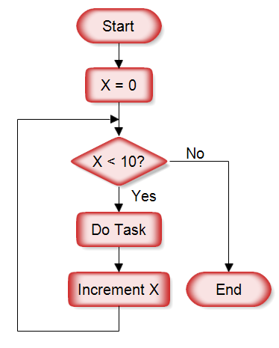
FOR Loop
A for loop enables a particular set of conditions to be executed repeatedly until a condition is satisfied.
Ex: Printing your name 100 times without writing it 100 times but 3.
Print X

Slide 11

Today’s learning:
Conditional Statements
Loop
Thank You!

